Slide 1
Barriers to Implementing a Just Culture in DevOps
Ian Lewis
05/04/25

Slide 2
Introduction
Just Culture in DevOps:
A Just Culture in DevOps promotes accountability and learning over blame.
Encourages open communication about errors to improve systems and processes.
Fosters an environment where team members feel safe to report issues without fear of retribution.

Slide 3
Barrier 1 – Blame-Oriented Culture
Tendency to assign blame to individuals for failure rather than examining systemic issues.
Discourages reporting of errors, hindering learning and improvement.
Creates a culture of fear, reducing innovation and collaboration.

Slide 4
Barrier 2 – Resistance to Cultural Change
DevOps requires a significant shift in organizational culture and mindset.
Employees may resist changes to established processes and roles.
Overcoming this resistance is crucial for successful Just Culture implementation.

Slide 5
Barrier 3 – Lack of Leadership Support
Successful cultural transformation requires commitment from top management.
Without leadership advocating for Just Culture principles, initiatives may falter.
Leaders must model desired behaviors and provide necessary resources.

Slide 6
Barrier 4 – Organizational Silos
Separate departments with limited communication hinder collaboration.
Silos prevent the free flow of information, essential for a Just Culture.
Breaking down silos fosters shared responsibility and collective learning.

Slide 7
Barrier 5 – Inadequate Tool Integration
Disparate tools and systems can impede transparency and accountability.
Lack of integrated tooling makes it difficult to track issues and learn from them.
Implementing cohesive toolchains supports a Just Culture by enabling visibility.

Slide 8
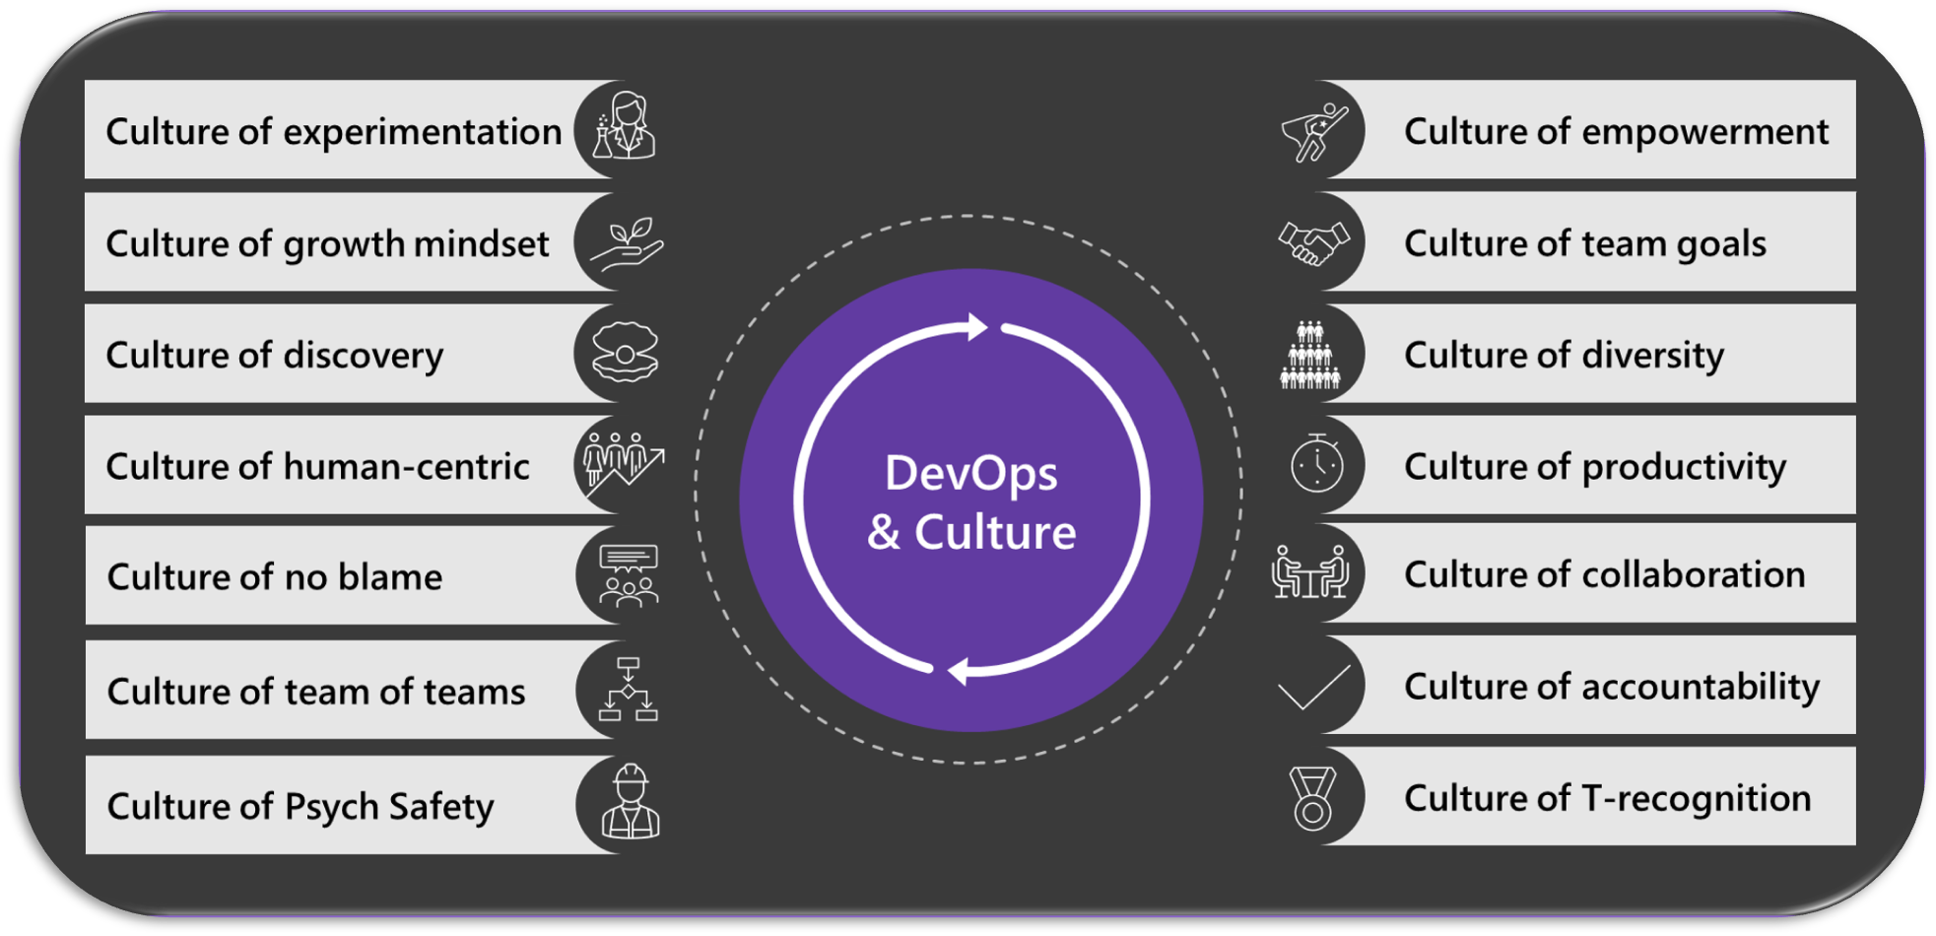
Source: https://devblogs.microsoft.com/devops/devops-dojo-customers-trust/

Slide 9
Key Takeaways
Strategies for Overcoming Barriers:
Promote Psychological Safety
Leadership Engagement
Cross-Functional Collaboration
Integrated Tooling
Continuous Education

Slide 10
Thank You
Sources:
HackerNoon. (n.d.). Cultural challenges in DevOps adoption and how to overcome them. https://hackernoon.com/cultural-challenges-in-devops-adoption-and-how-to-overcome-them
IAmOnDemand. (n.d.). 5 reasons your company is struggling to implement a DevOps culture. https://iamondemand.com/blog/5-reasons-your-company-is-struggling-to-implement-a-devops-culture/
KnowledgeHut. (n.d.). Top 10 DevOps implementation challenges and how to overcome them. https://www.knowledgehut.com/blog/devops/devops-implementation-challenges
LinkedIn. (n.d.). Challenges in implementing DevOps culture in large business. https://www.linkedin.com/pulse/challenges-implementing-devops-culture-large-business-niazi
Nerdbot. (2025, March 22). Top 6 DevOps implementation challenges and how to overcome them. https://nerdbot.com/2025/03/22/top-6-devops-implementation-challenges-and-how-to-overcome-them/
Sematext. (n.d.). Top 15 DevOps challenges and how to overcome them. https://sematext.com/blog/devops-challenges/

